Slide 1
MGMT 58600: Python Programming
Lecture 2
Dr. Shoaib Khan

Slide 2
Variables and Assignment
You can name a variable anything as long as it obeys the following three rules:
It can be only one word with no spaces.
It can use only letters, numbers, and the underscore (_) character.
It can’t begin with a number.

Slide 3
First Program
Now it’s time to create your first program! When the file editor window opens, enter the following into it:
➊ # This program says hello and asks for my name & age. ➋ print('Hello, world!’) print('What is your name?') # ask for their name ➌ myName = input() ➍ print('It is good to meet you, ' + myName) ➎ print('The length of your name is:') print(len(myName)) ➏ print('What is your age?') # ask for their age myAge = input() print('You will be ' + str(int(myAge) + 1) + ' in a year.')

Slide 4
Dissecting the Program
Comments: The following line is called a comment.
➊ # This program says hello and asks for my name.
Python ignores comments, and you can use them to write notes or remind yourself what the code is trying to do.
The print() Function: Displays the string value inside its parentheses on the screen.
➋ print('Hello, world!') print('What is your name?') # ask for their name
The input() Function: The input() function waits for the user to type some text on the keyboard and press ENTER.
➌ myName = input()

Slide 5
Dissecting the Program
Printing the User’s Name: The following call to print() actually contains the expression 'It is good to meet you, ' + myName between the parentheses.
The len() Function: You can pass the len() function a string value (or a variable containing a string), and the function returns the integer value of the number of characters in that string.
The str(), int(), and float() Functions:
If you want to concatenate an integer such as 29 with a string to pass to print(), you’ll need to get the value '29', which is the string form of 29.
The str() function can be passed an integer value and will evaluate to a string value version of the integer, as follows:
>>> str(29) '29' >>> print('I am ' + str(29) + ' years old.') I am 29 years old.

Slide 6
Boolean Datatype
Boolean data type has only two values: True and False.
Like basic datatypes, Boolean values are used in expressions and can be stored in variables
Comparison operators, also called relational operators, compare two values and evaluate down to a single Boolean value

Slide 7
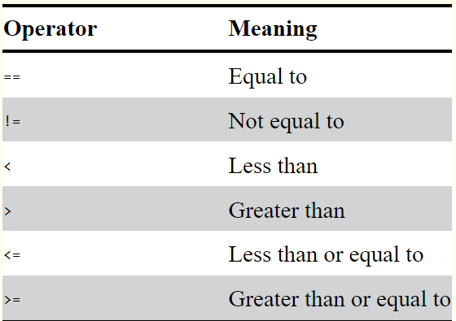
Comparison Operators
Comparison Operators: These operators evaluate to True or False depending on the values you give them.

Slide 8
Boolean Operators
The three Boolean operators (and, or, and not) are sometimes used to combine Boolean expressions.
Like comparison operators, they evaluate these expressions down to a Boolean value.
The and and or operators always take two Boolean values (or expressions), so they’re considered binary operators.
The and operator evaluates an expression to True if both Boolean values are True; otherwise, it evaluates to False

Slide 9
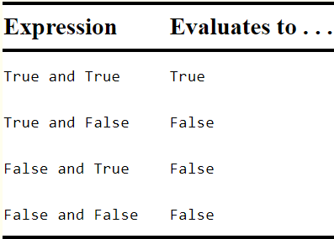
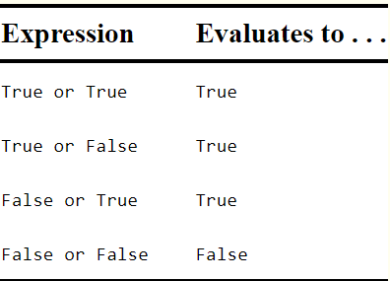
Boolean Operators
The and Operator’s Truth Table:
The or operator evaluates an expression to True if either of the two Boolean values is True. If both are False, it evaluates to False.
The or Operator’s Truth Table:

Slide 10
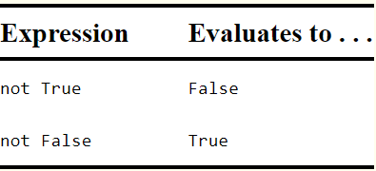
Boolean Operators
Unlike and and or, the not operator operates on only one Boolean value (or expression). This makes it a unary operator.
The not operator simply evaluates to the opposite Boolean value.
The not Operator’s Truth Table:

Slide 11
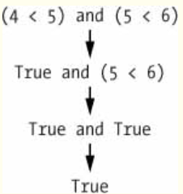
Mixing Boolean and Comparison Operators
Since the comparison operators evaluate to Boolean values, you can use them in expressions with the Boolean operators.
Recall that the and, or, and not operators are called Boolean operators because they always operate on the Boolean values True and False.
While expressions like 4 < 5 contain non-Boolean values, they are expressions that evaluate down to Boolean values.
Evaluate: >>> (4 < 5) and (5 < 6) True

Slide 12
Control Flow
A program’s control flow is the order in which the program’s instructions execute.
The control flow of a Python program is regulated by conditional statements, loops, and function calls.
Python has three types of control structures:
Sequential - default mode
Selection - used for decisions and branching
Repetition - used for looping, i.e., repeating a piece of code multiple times.

Slide 13
Selection/Decision
a.k.a. Decision control statements or branching statements.
Some decision control statements are:
if
if-else
nested if
if-elif-else

Slide 14
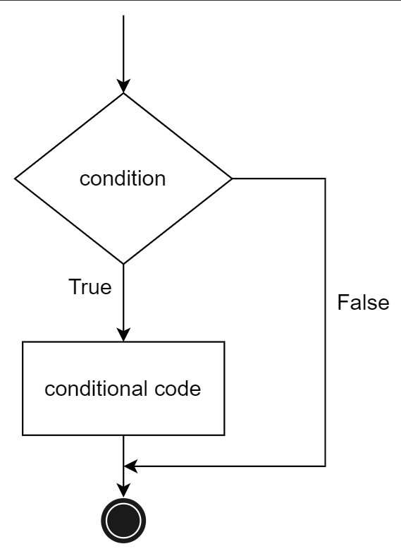
Selection/Decision
if – allows us to run a particular block of code, but only when a certain condition is satisfied. It has one condition to check.
if <condition>:
<statement>
n = 10
if n % 2 == 0:
print("n is an even number")

Slide 15
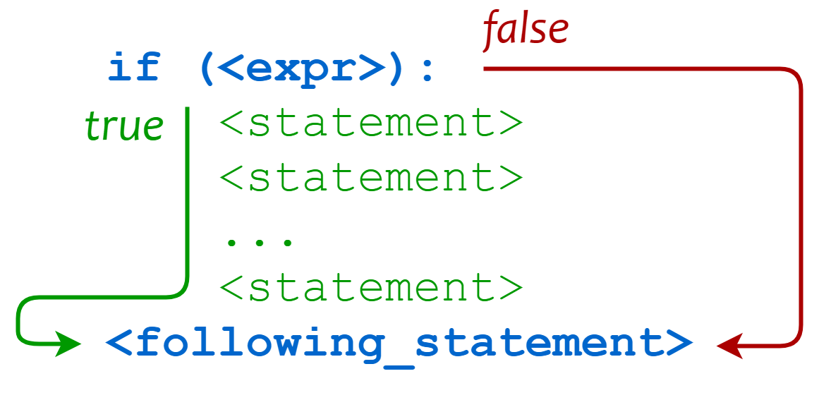
Grouping Statements: Indentation and Blocks
Suppose you want to evaluate a condition and then do more than one thing if it is true:
If the weather is nice, then I will:
Mow the lawn
Weed the garden
Take the dog for a walk
(If the weather isn’t nice, then I won’t do any of these things.)
if <expr>:
<statement>
<statement>
...
<statement>
<following_statement>
All statements at the matching indentation level are considered part of the same code block

Slide 16
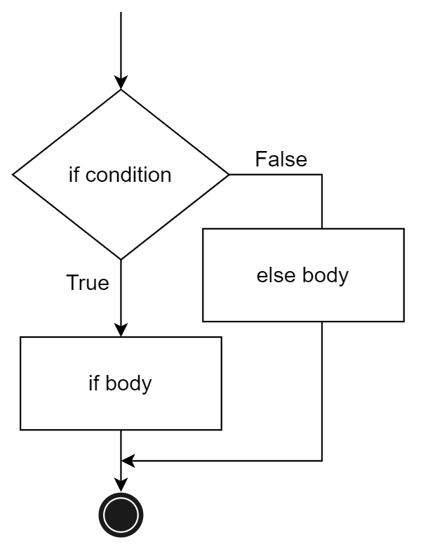
The if-else Clause
The if-else statement evaluates the condition and executes the block of if, when the test condition is True, but when the condition is False, the block of else is executed.
if <expr>:
<statement(s)>
else:
<statement(s)>
n = 5
if n % 2 == 0:
print("n is even")
else:
print("n is odd")

Slide 17
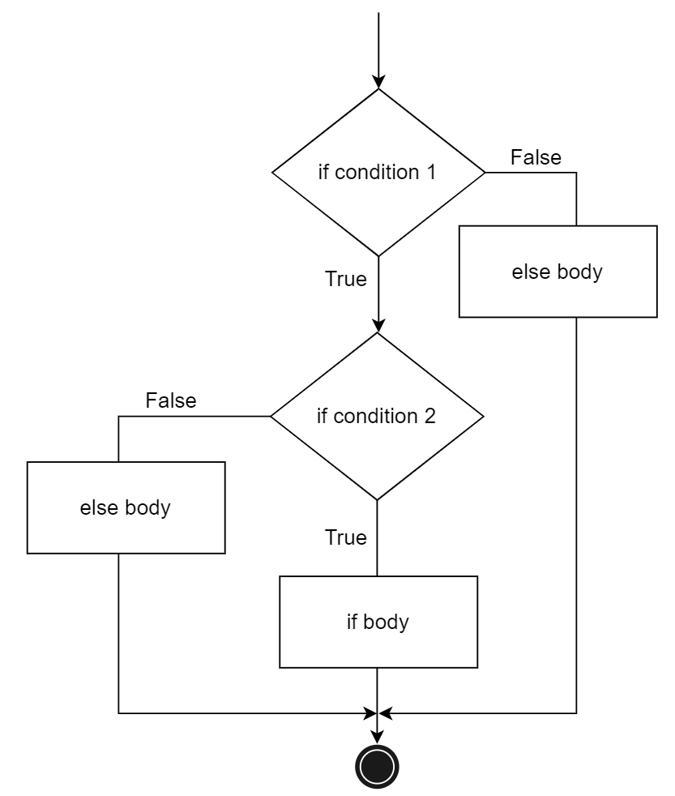
Nested if
Nested if statements are one or more if statement inside another if statement.
a = 20
b = 10
c = 15
if a > b:
if a > c:
print("a value is big")
else:
print("c value is big")
elif b > c:
print("b value is big")
else:
print("c is big")

Slide 18
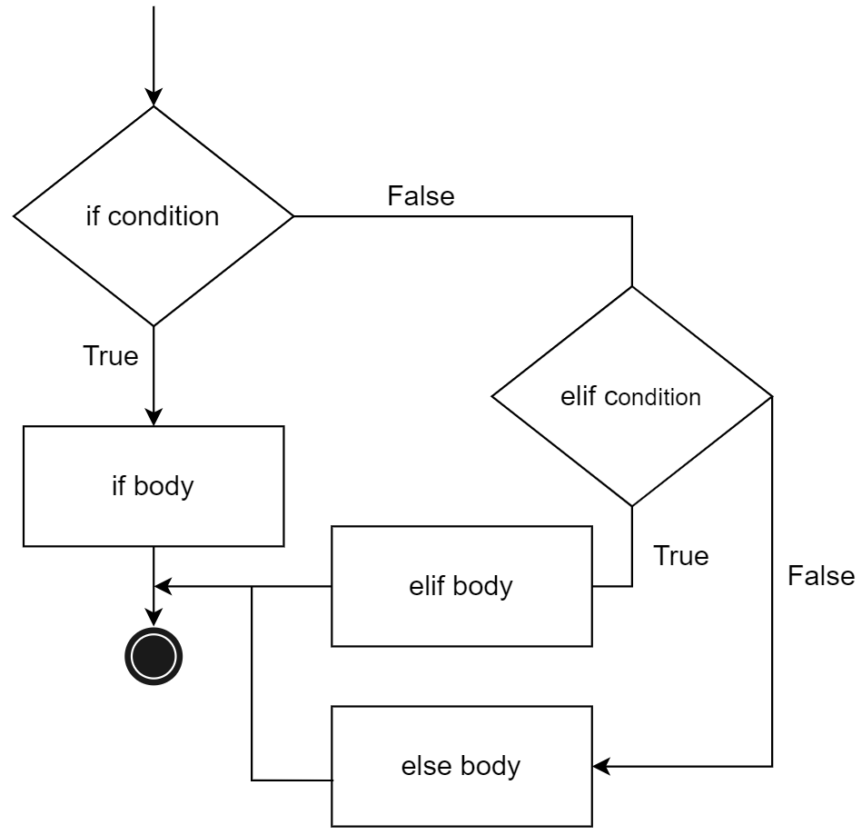
if-elif-else
Sometimes we need to branch execution based on several alternatives.
For this, use one or more elif (short for else if) clauses.
if <expr>:
<statement(s)>
elif <expr>:
<statement(s)>
elif <expr>:
<statement(s)>
...
else:
<statement(s)>
Python evaluates each <expr> in turn and executes the block corresponding to the first that is true.
If none of the expressions are true, and an else clause is specified, then its block is executed.

Slide 19
if-elif-else
x = 15
y = 12
if x == y:
print("Both are Equal")
elif x > y:
print("x is greater than y")
else:
print("x is smaller than y")

Slide 20
Repetition
A repetition statement is used to repeat a group(block) of programming instructions.
In Python, we generally have two loops/repetitive statements:
for loop (definite iteration)
while loop (indefinite iteration)

Slide 21
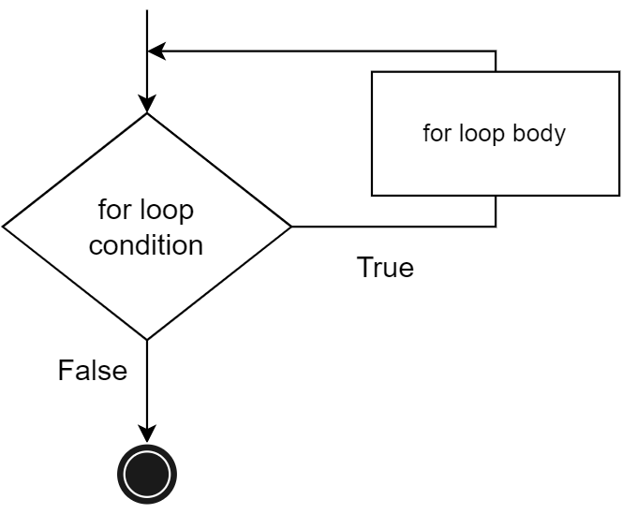
for Loop
A for loop is used to iterate over a sequence (a list, tuple, dictionary, or a set). We can execute a set of statements once for each item in the sequence.
for <var> in <iterable>:
<statement(s)>
print("1st example")
lst = [1, 2, 3]
for i in range(len(lst)):
print(lst[i], end = " \n")
print("2nd example")
for j in range(0,5):
print(j, end = " \n")

Slide 22
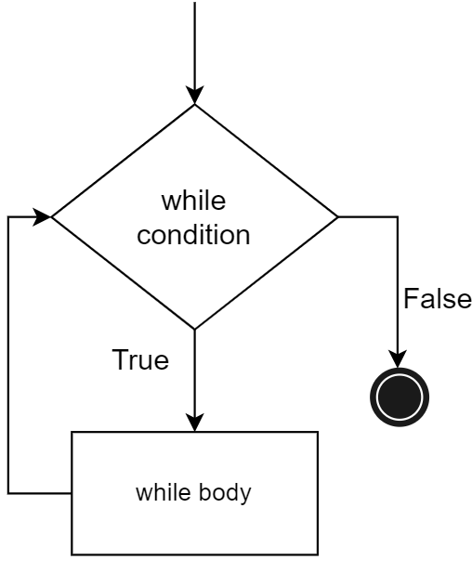
while Loop
while loops are used to execute a block of statements repeatedly until a given condition is satisfied.
The expression is checked in each iteration and, if it is still true, the body is executed again…
..until the expression becomes false.
while <expr>:
<statement(s)>
m = 5
i = 0
while i < m:
print(i, end = " ")
i = i + 1
print("End")

Slide 23
Functions
A function is a packaged block of statements that performs a specific task
A function has a name and only runs when it is called.
You can pass data, known as parameters (or arguments), into a function.
A function can return data (output or return value) as a result.
There are two types of function in Python programming:
Standard library functions - These are built-in functions in Python that are available to use e.g. print(), len(), str(), int() etc.
User-defined functions - We can create our own functions based on our requirements.

Slide 24
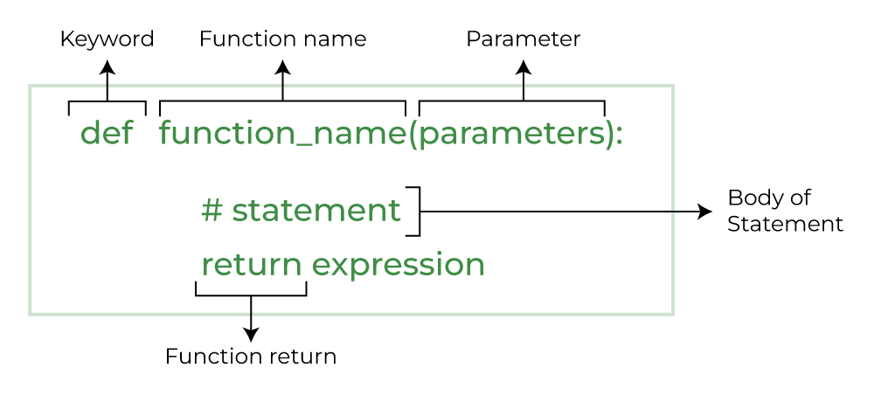
Python Function Declaration
The syntax to declare a function is:

Slide 25
Some Examples
# A simple Python function
def fun():
print("Welcome to MGMT 586")
# Driver code to call a function
fun()
def add(num1, num2):
"""Add two numbers"""
num3 = num1 + num2
return num3
# Driver code
num1, num2 = 5, 15
ans = add(num1, num2)
print(f"The addition of {num1} and {num2} results {ans}.")

Slide 26
Why Use Functions?
Dividing a complex problem into smaller chunks makes our program easy to understand and implement
Reduces duplicate code within a program
Enables reuse of code across multiple programs
Divides a large programming task among various programmers or various stages of a project
Hides implementation details from users of the function
Improves readability of code by replacing a block of code with a function call where a descriptive function name serves to describe the block of code
Makes software easier to test, debug and maintain

Slide 27
Call Stack
A Stack is a Last-In-First-Out (LIFO) data structure
The call stack (an OS level stack) is how a program remembers where to return the execution after each function call.
The call stack isn’t stored in a variable in your program; rather, Python handles it behind the scenes.
When your program calls a function, Python creates a frame object on the top of the call stack.
Frame objects store the line number of the original function call so that Python can remember where to return.
If another function call is made, Python puts another frame object on the call stack above the current one.

Slide 28
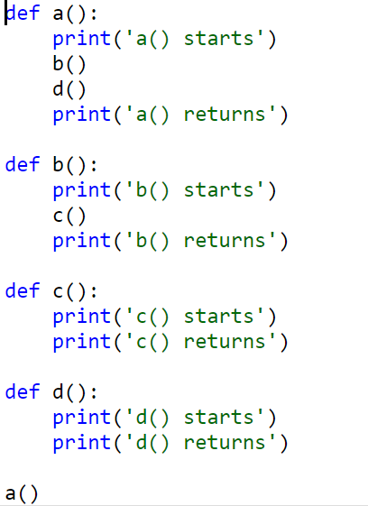
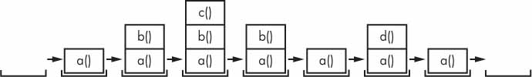
Call Stack Example

Slide 29
Scope of Variables
Parameters and variables that are assigned inside a function are said to exist in that function’s local scope.
Variables that are assigned outside all functions are said to exist in the global scope.
A variable that exists in a local scope is called a local variable
A variable that exists in the global scope is called a global variable.

Slide 30
Scoping Rules
Local variables cannot be used in the global scope
def spam(): eggs = 31337 spam() print(eggs)
Local scopes cannot use variables in other local scopes
def spam(): eggs = 99 bacon() print(eggs) def bacon(): ham = 101 eggs = 0 spam()

Slide 31
Scoping Rules
Global variables can be read from a local scope
def spam(): print(eggs)
eggs = 42 spam() print(eggs)
Local and global variables with the same name
def spam(): eggs = 'spam local' print(eggs) # prints 'spam local' def bacon(): eggs = 'bacon local' print(eggs) # prints 'bacon local' spam() print(eggs) # prints 'bacon local’ eggs = 'global' bacon() print(eggs) # prints 'global'

Slide 32
The global Statement
If you need to modify a global variable from within a function, use the global statement
def spam(): global eggs eggs = 'spam' eggs = 'global' spam() print(eggs)

Slide 33
Four Rules
There are four rules to tell whether a variable is in a local scope or global scope:
If a variable is being used in the global scope (that is, outside of all functions), then it is always a global variable.
If there is a global statement for that variable in a function, it is a global variable.
Otherwise, if the variable is used in an assignment statement in the function, it is a local variable.
But if the variable is not used in an assignment statement, it is a global variable.

